Slide 1
Инициация инноваций и маркетинг инновационной продукции
Максимов С.И.
Республиканский семинар
«Маркетинговое продвижение инновационных разработок и научно-технической продукции на отечественном и зарубежных рынках»
БелИСА, 24 апреля 2015 года

Slide 2
Marketing
is the process by which sellers find buyers and by which goods and services move from producers to consumers.

Slide 3
Marketing activities I
Market research is the study of the probable users of products or services. Such potential customers are called a market.
Product development is the determining the various goods to be offered, as well as developing the products themselves. Manufacturers continually meet the demands of the public by adding new products, changing exising ones, and dropping others.

Slide 4
Marketing activities II
Distribution is the movement of goods and services from producer to consumer. A manufacturer must establish a system the keeps products moving steadily from the factory to the consumer. Such a system is called a marketing channel or a channel of distribution. Many types of companies take part in distribution. They include wholesalers who sell large quantities of goods to retailers. The retailers, in turn, sell small numbers of products to consumers.

Slide 5
Marketing activities III
Pricing. When setting the price of a product, most manufacturers start with their unit production cost, the expence of making one unit of the item. They add a percentage of this cost to provide a profit for themselves. Each firm that take part in the marketing of the goods, i.e. is a provider in the marketing channel adds an amount that covers its expences and enables it to make a profit. The amount added at each stage is called a markup. The final selling price of an item equals its production cost plus the total of markups.

Slide 6
Marketing activities IV
Promotion includes advertising, catalogues, coupons, direct-mail, in-store displays, and door-to-door sales.
Advertising (advert or ad) is a message designed to promote a product, a service, or an idea. Printed ads make up a large part of newspapers and magazines. Poster ads appear on many buses, and in shops and other public buildings. Commercials are ads which interrupt TV and radio programs.
Salesmanship is the ability to sell goods and services. It involves informing and persuading to buy.

Slide 7
Advertising (opt.)
Countries with large advertising industry:
The US (all types of ads are legal)
France (all types of ads are legal)
Germany (all types of ads are legal)
Japan (all types of ads are legal)
The UK (all types of ads are legal)
…….
Norway (commercials are illegal)
Sweden (commercials are illegal)

Slide 8
Advertising techniques (opt.)
Basic appeals to buying goods or sevices may rely on the facts about goods and services or/and on human emotions and be made using:
Attention-getiing headlines
Slogans
Testimonials (ads in which a person endorses a product)
Product characters (fictional people and animals)
Comparison of products
Repetition

Slide 9
Salesmanship (opt. 1)
Kinds of selling:
Selling by manufacturers
Retail selling
Other types (agents, dealers)

Slide 10
Salesmanship (opt. 2)
Steps of selling:
Prospecting (identifying possible customers, who are called prospects)
Presentation (a three-step outline: recognition of the preospect’s needs, demonstration that the product offered will satisfy those needs, asking for the order)
Persuasion (to grant prospects a trial period for using the product)
Aftersales responsibilities

Slide 11
“Innovation is the successful exploitation of new ideas”
They can be embodied in inventions, in the goods and services with new or improved characteristics and services, and in technologies.

Slide 12
Initiation innovation
Initiation innovation is an activity aimed at setting the goal and tasks of innovation, and at finding out of their ideas and concept.
http://ec.europa.eu/eurostat/statistics-explained/index.php/Innovation_statistics
http://ec.europa.eu/research/innovation-union/index_en.cfm?pg=keydocs
http://bsc.by/story/s-12-po-18-maya-t-g-upravlenie-stroitelnymi-proektami-v-izraile

Slide 13
Technology
Technological innovation is the using of new methods of producing new products. In the UK, there is Queen’s Awards for Export and Technology for outstanding achivement in increasing exports or technological innovation. The awards can be won by any branch of industry, including agriculture. The holders are entitled to display the corresponding emblem (with a letter E or T depending on the field of achivement) on their printed stationery and on their products if they wish.

Slide 14
Products
Innovative products?
Two main cathegories:
Present ones serving for new goals
Very new ones, have not existing earlier, but serving for either new or existing demands

Slide 15
How to market an innovative product
Appeal to a marketing company or
Establishing a marketing office in your company
whose task will to do marketing analysis and make up a marketing plan with comprehensive use of office applications and special software, e.g. MS Project, Sales & Marketing Pro, etc.Sales & Marketing Pro

Slide 16
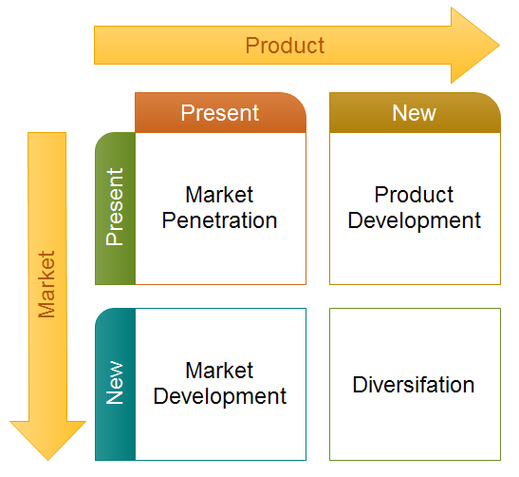
Instruments. Ansoff Matrix.
http://www.f-abp.ru/page.php?a=2ansoff

Slide 17
Innovation Psychology Questions
What Happens When Leadership Focus Shifts Away From Innovation?
What Is An Employee Innovation Network, And Why Should You Care?
Does Innovation depend on Personality Types?
https://www.innovationmanagement.se/category/blogs/innovation-psychology/

Slide 18
It was just the tip of the iceberg ....
The End
Thanks!

