Slide 1
Policy options and recommendations
José Palacín
Chief, Innovative Policies Development
UNECE
Minsk, 19 June 2014

Slide 2
Where to start?
Eco-innovation concerns multiple actors and objectives
Greening the economy is a large-scale transformation
Priority- setting with the involvement of multiple stakeholders
Broad consensus on the actions that need to be taken

Slide 3
An integrated approach: barriers and benefits
Barriers:
Incentives not adapted to cross-sectorial work
Multi-sectoral tools are less developed
Legal framework not adapted to inter-sectoral cooperation
Benefits:
Balanced decision-making, reducing conflicts between policy fields
Increase the capacity to meet complex goals
Improve understanding of policies in other sectors
Address financial constraints

Slide 4
Policy as partnership
Business sector as source of innovations
Public sector creates incentives and removes obstacles for green innovations
(different types of market failures; power of incumbents)
The aim of policies is to influence the behavior of the business sector (and households)
Most instruments rely on some form of collaboration between the public and the business sector

Slide 5
Eco-innovation policy mix
Creation of clear and stable market signals (carbon pricing)
Public investment in basic research
Support for private investment in eco-innovation
Support for general purpose technologies
Fostering the growth of new companies
Facilitates the adoption of green innovation by SMEs
Fostering diffusion of green technologies
Strengthening markets for eco-innovation
Consumer policy and education to encourage uptaking green innovations

Slide 6
How to create incentives for eco-innovation?
Set realistic targets (short-,medium and long-term) for expected environmental performance
Avoid unanticipated large changes in policy parameters
Define a predictable policy regime: instability creates investor uncertainty and leads to postponement of investments in innovative activities

Slide 7
The importance of flexibility
Focus on environmental outcomes
Firms should be allowed to identify the best way to meet environmental objectives
Technology-neutrality
BUT…
Some technologies or solutions may have been demonstrated elsewhere
Catching-up countries have a latecomer advantage
Some technologies may be seen as having larger potential but also large initial barriers
Support may reflect natural endowments

Slide 8
Recommendations
Framework conditions
Four key areas:
Implementation of commercial and financial laws (IP, PPP)
Human capital formation (including in the public sector)
Competition (as a driver of innovation)
Financial markets

Slide 9
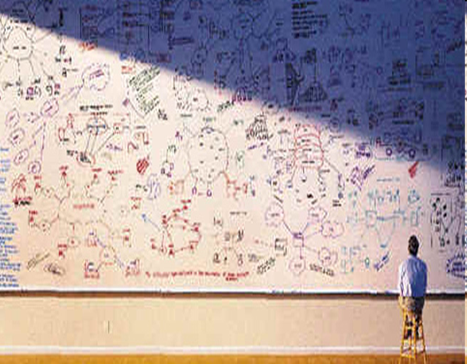
Recommendations
Innovation governance
Continue efforts to establish a coherent NIS
Green growth and eco-innovation as part of a general innovation/development strategy
Create structures for the discussion on green technologies among stakeholders
Pay attention to the need for coordination

Slide 10
Recommendations
R&D spending
Green growth and eco-innovation are particularly research intensive:
Allocate public funding to research in priority areas
Promote private expenditures through incentives
Use actively international cooperation – including for funding
Support vocational training programmes

Slide 11
Recommendations
Demand for eco-innovation
Develop green public procurement mechanisms
Ensure that it is simple, so SMEs can compete
Introduce modern energy-efficiency standards, building codes and infrastructure resilience parameters
Develop efforts to ensure that the prices of natural resources reflect their cost (protecting vulnerable people when necessary).

Slide 12
Recommendations
Develop collaboration and partnerships
Between policymakers from different fields
Between different stakeholders

Slide 13

Recommendations
Facilitate diffusion of innovation through linkages:
The effective adaptation to climate change will depend largely on the development and diffusion of innovative and environmentally sound technologies
Knowledge is not useful if not widely applied
Double policy dimension: scope of application and pace of diffusion
Develop a life-cycle approach
Create organizational structures to support eco-innovation, such as technology business incubators and technology transfer offices
Set up incentives that encourage cooperation between stakeholders
Encourage relations between FDI and local firms

Slide 14
Recommendations
Increase available financing instruments for eco-innovation:
Increase public financing, including grant schemes and other forms of support at the pre-commercialization phase
Facilitate the creation of project-based consortia bringing together industry and science/different types of firms
Explore the possibility of using public-private partnership to finance new infrastructure
Exploit fully the financial possibilities opened by international cooperation
Support the development of specialized financial intermediaries

Slide 15

A map into the future
Policy learning as part of the cycle of policymaking - evaluation is complicated in the presence of multiple objectives
International exchange of experiences – but national specificities should be taken into account
Eco-innovation roadmaps can provide guidance

Slide 16
Thank you!
José Palacín
Jose.palacin@unece.org
Phone +41 22 917 16 43

