Slide 1
Policy instruments to foster green technologies
José Palacín
Chief, Innovative Policies Development
UNECE
Minsk, 19 June 2014

Slide 2
What is eco-innovation?
Any type of innovation that
benefits the environment
reduces the environmental impact of economic activities
Eco-innovation may be non-technological and take place in non-environmental areas

Slide 3
Environment and innovation policies
Environmental innovation requires effective policy coordination between ministries and agencies in charge of:
innovation
industrial sector development
environmental protection
Green technology innovations as an integral part of sectoral development strategies

Slide 4
Why public policies are essential?
Innovation is complex- many sectors are involved and coordination is required
Market failures are widespread – appropriate valuation of environmental costs and benefits is lacking
Focus beyond financial resources – strategic guidance
Financing problems
Maximise impact – emphasis on dissemination

Slide 5
A balance of policies/instruments
Supporting cutting-edge (frontier) innovation and catch-up innovation
Improvement of domestic absorptive capacity to facilitate the adoption and dissemination of existing technologies
Different types of instruments for these different objectives

Slide 6
What are the targets?
Generation of knowledge
Absorptive capacity
Diffusion of innovation
Stimulating demand for innovation
Improving innovation governance

Slide 7
Where to start?
The price system defines the system of incentives
Cost-minimization encourages reductions in the use of resources
But environmental costs are not fully reflected in prices (externalities)
Inconsistency between policies ( energy subsidies vs energy saving)

Slide 8
Getting prices right
This is complicated - politically and technically
Not a sufficient condition:
Longer-term investments under uncertain conditions
Government intervention to price externalities – risk of reversal
Need to share the risks now to reduce the likelihood of changes in the future
Pricing policies to be complemented by more targeted policies

Slide 9
Types of interventions
Technology push
Reduce the cost of knowledge creation before commercialization
Demand or market pull
Increase revenues from sales after commercialization

Slide 10
Cutting edge innovation
Technology push:
Appropriate for countries with strong enough technological capabilities
Different tools: direct funding of research, grants and loans, R&D incentives
More effective than demand to generate new technologies

Slide 11
Cutting edge innovation
Demand or market pull:
Prize funds – defined objectives
Advanced market commitments or purchase guarantees – clear technological specifications

Slide 12
Catch-up innovation and absorption
Creation of a business environment conducive to experimentation and learning:
Regulations to wind up a business
Factors influencing entrepreneurship
Improved human capital and increased connectivity:
Insertion in global value chains
International mobility
Development of skills - multidisciplinary

Slide 13
Catch-up innovation
Facilitate access to technologies: openness to trade, FDI, licensing of foreign technologies, patent pools, compulsory licenses
Encourage adoption of green technologies (demand-pull):
feed-in tariffs
tax credits for users of new technologies
comparison/endorsement labelling
regulations, standards, green procurement
Demand policies more suitable for incremental, not radical innovation

Slide 14
The importance of partnerships
Bringing together agents involved in the whole production/consumption cycle
Life-cycle approach – framework to integrate a large number of interventions
Voluntary standards – bringing stakeholders along the supply chain

Slide 15
Financing
Key challenge: How to maximise the impact of public funding
Influence on innovation capabilities – what to support
Attract other sources of investment – how to attract private/international funding

Slide 16
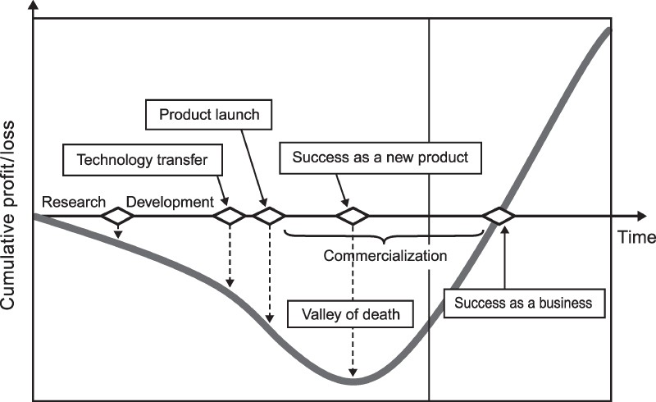
Financing: Overcoming the «valley of death»

Slide 17
Financing
Companies trying to develop clean technologies face particular difficulties:
Dependence on government policy is a source of risk
Long term investment horizons and substantial capital
End product difficult to differentiate
Lack of experienced investment managers
Exit opportunities

Slide 18
Financing
Collaboration between the public and the private sectors to increase the supply of finance
Indirect ways to mobilize private financing:
creation of opportunities through R&D expenditures
creation of a market for environmental technologies
development of exit possibilities
Supply solutions are not always the only answer

Slide 19
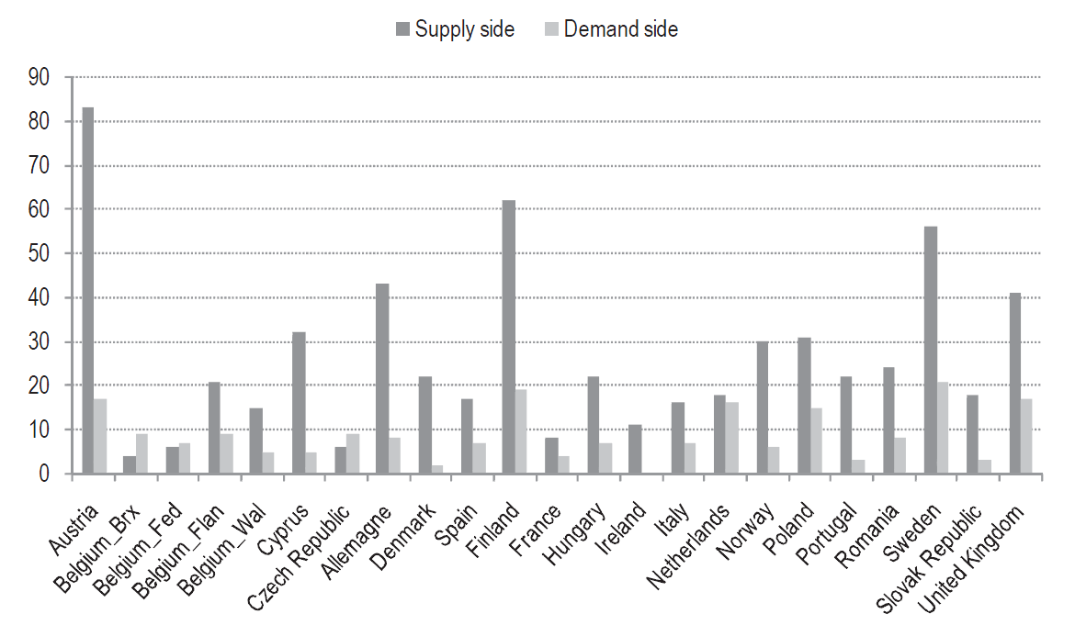
Balance between instruments

Slide 20
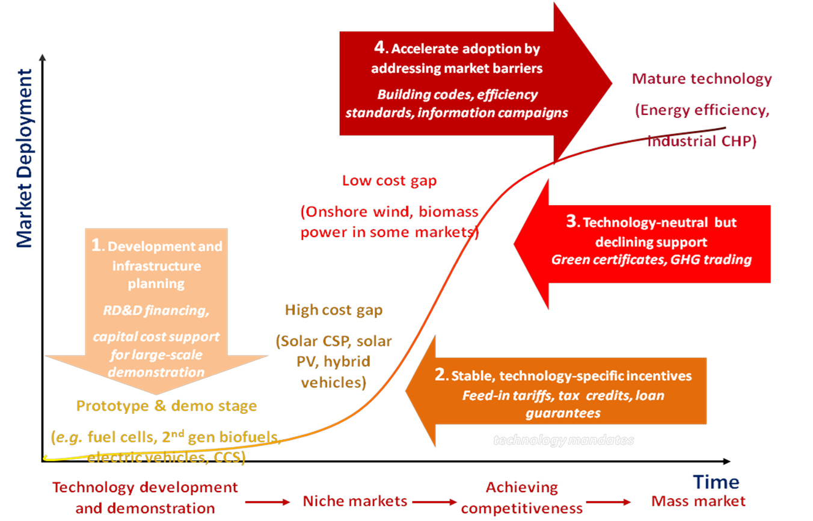
Policies and technology maturity

Slide 21
Case study: Portugal solar tiles
The product fits national construction traditions
Developed by a consortium: industry, research and government
Presence of users in the consortium
Different policy instruments available: generic innovation incentives, feed-in tariffs, tax exemptions..
Push to change standards to mobilise demand

Slide 22
Thank you!
José Palacín
Jose.palacin@unece.org
Phone +41 22 917 16 43

